Slide 1

SCTS – Projects
Christophe THIVET
02/09/2016

Slide 2
Minimal Methodology

Slide 3

Minimal Methodology
Target
NEW projects
Projects in the initial phase
Items/Components
PID
MS-Project Schedule
Monthly Status Report
Lessons Learned and CloseOut document

Slide 4
Minimal Methodology
Target
NEW projects
Projects in the initial phase
Items/Components
PID
MS-Project Schedule
Monthly Status Report
Lessons Learned and CloseOut document
Why?

Slide 5
Minimal Methodology
Benefits
PID
MS-Project Schedule
Monthly Status Report
Lessons Learned and CloseOut document
PID
a clear scope
stakeholders/clients ………………. (declare the end of project)
ROI
EPM Live

Slide 6
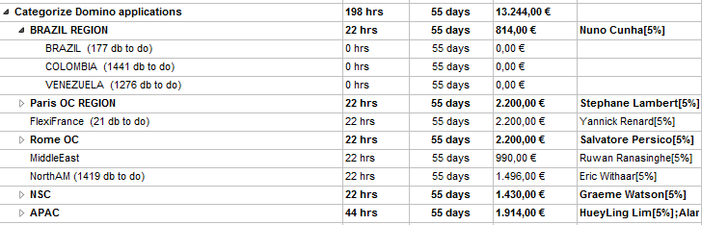
Minimal Methodology
Benefits
PID
MS-Project Schedule
Monthly Status Report
Lessons Learned and CloseOut document
Visibility
Planning
Control timeline
Monitor costs
Schedule

Slide 7
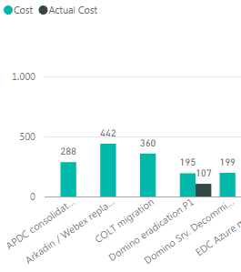
Minimal Methodology
Benefits
PID
MS-Project Schedule
Monthly Status Report
Lessons Learned and CloseOut document
Visibility
Planning
Control timeline
Monitor costs
Schedule
used to Baseline
Monetize our projects... Not only the savings

Slide 8
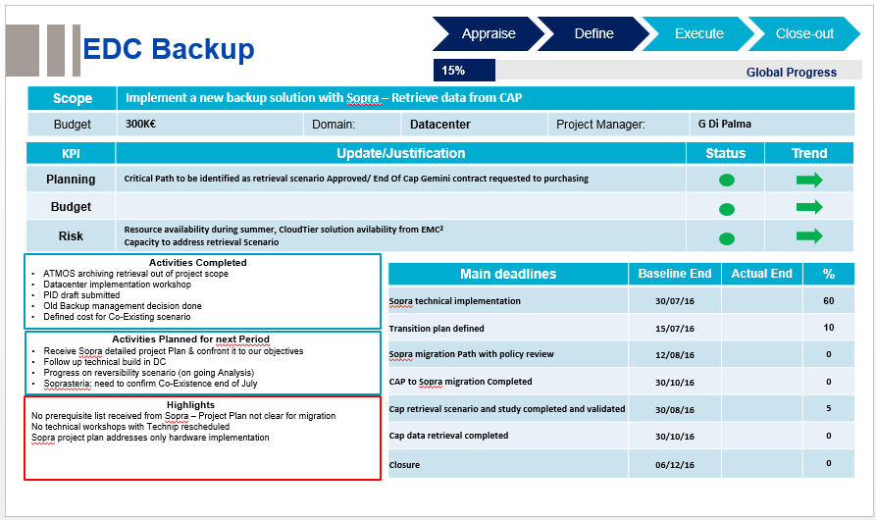
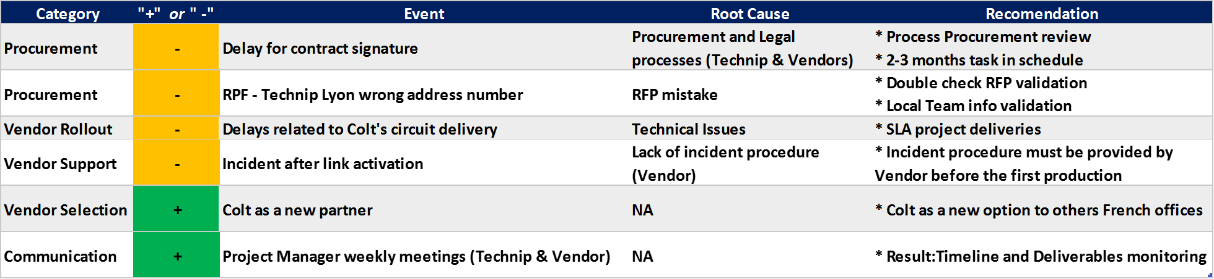
Minimal Methodology
Benefits
PID
MS-Project Schedule
Monthly Status Report
Lessons Learned and CloseOut document
Many info come
from Schedule
Status Report
Lessons Learned

Slide 9
Minimal Methodology
Next PMO meeting
Status Report
Schedule up to date
New schedules to come
12 up to date
05 to come
17
total

Slide 10
SCTS quantitative indicators

Slide 11
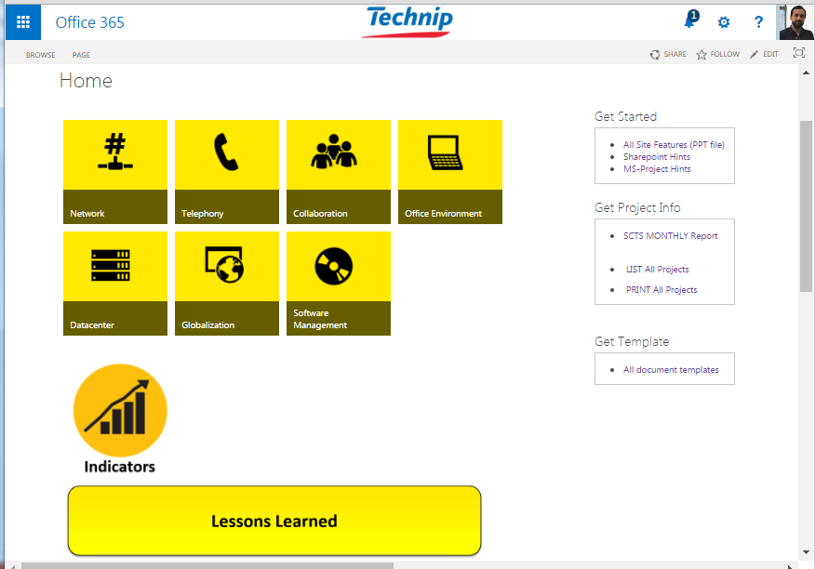
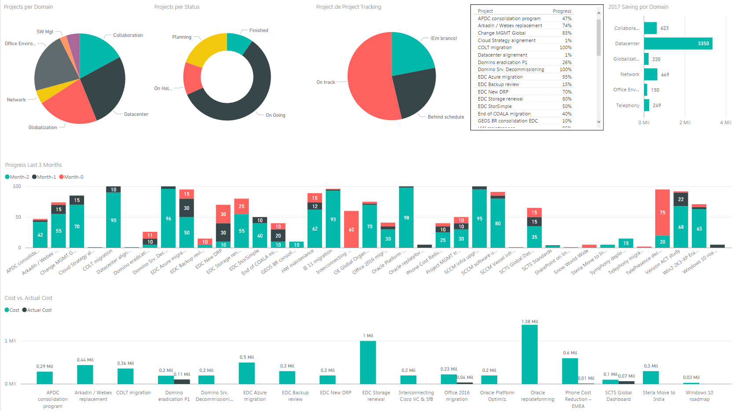
Quantitative Indicators
Site Up to Date
Indicators
https://technip.sharepoint.com/sites/SCTSpmo

Slide 12
Savings Categories

Slide 13

Savings Categories
3 types:
RB – Real Saving
e.g. COLT project
CA – Cost Avoidance
e.g. Oracle Platform Optimization
PI – Performance Improvement
e.g. SCTS standards
**To be considered in NEW PIDs (ROI)
Notes:
RB: like Verizon vs. Colt contracts negotiation
CA: like Oracle Fines
PI: like: “increase staff productivity” or “reduce the IT support”

Slide 14
EPM Live

Slide 15
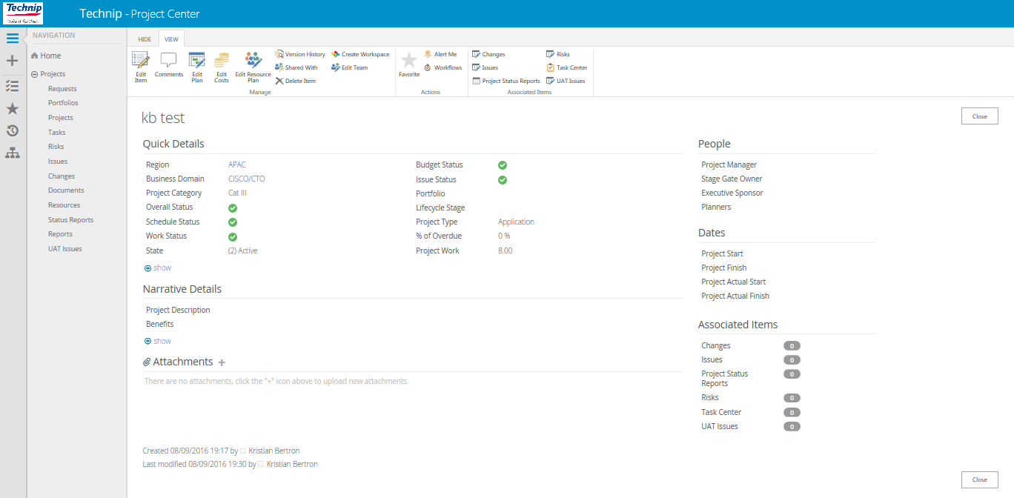

EPM Live - Global Tool for Project Management
New version is coming: EPM Live 2013
Improve the quality of project and portfolio process
Out-of-the-Box functionality
Project Status for this New Version:
New Environment in place
BTO - Build To Order questionnaire
UAT tests (in progress)
EPM Live training (Oct.)
Benefits:
PID + MS-Schedule( ) + Status Reports + Issues (as our own minimal methodology)
Resource allocation + Costs + Portfolio
Global Reports
SCTS will be 100% compliance, because 100% of our projects are in SCTS PMO.
Notes:
RB: like Verizon vs. Colt contracts negotiation
CA: like Oracle Fines
PI: like: “increase staff productivity” or “reduce the IT support”

Slide 16
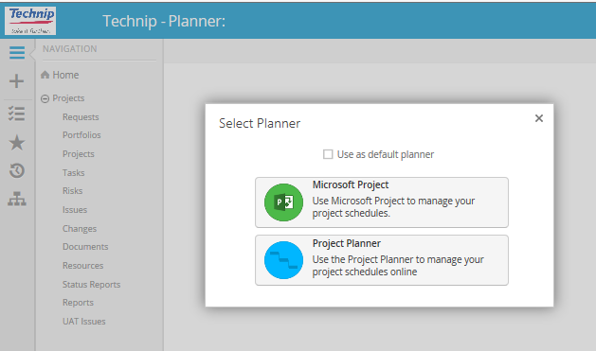
EPM Live - Global Tool for Project Management
Topics to be Tested
Speed
Replication of information (e.g. change status on schedule and metadata)
NO AD integration vs. Resource allocation + Roles + Visibility
e-ITPID process
Reports – how are they?
Notes:
RB: like Verizon vs. Colt contracts negotiation
CA: like Oracle Fines
PI: like: “increase staff productivity” or “reduce the IT support”

Slide 17
Dashboard of Projects

Slide 18
No Information
SCTS Monthly Report – August 2016
0% < deviation < 20%
Project | PM | Progress | Planning | Budget | Risk | 2017 Saving KEUR | Comments
COLT migration | Eric Rolland | 100% |  |  |  | 199 | Project finished. Sites Migrated: Genesis Paris, Adria, Le Trait, Rueil, TCS and Lyon.
Verizon ACT study | Eric Rolland | 95% |  |  |  | 450 | Verizon Study was presented to each Region. Feedbacks will be consolidated and reverted to Verizon until mid Sept.
deviation ≥ 20%
Network
Phone Cost Reduction – EMEA | Muriel R. | 45% |  |  |  | 249 | Paris will start a Pilot in October. Due to contract aspects,France rollout to Mar/17 Frankfurt and Rome sites are under analysis.
Telephony migration to SfB | Graeme/Alister | 2% |  |  |  | IN ANALYSIS | Project Kick-off meeting.
Telephony
TelePresence decommissioning | Elle F. | 95% |  |  |  | 69 | Prepare a final communication to ITDs regarding the details of the Telepresence infrastructure decommissioning.
Interconnecting Cisco VC & TP Infra with Microsoft Skype | Elle F. | 70% |  |  |  | 96 | POC on going. Content Sharing feature not consistent between VC and SfB. Intercall Solution deadline: 12-Sep.
Arkadin / Webex replacement | Hélio Vieira | 74% |  |  |  | 198 | Last Users Rollout phase (USA, Paris, Italy) to be activated by September. Service Desk Rollout Completed - able to support the End Users.
End of COALA migration | Elle F. | 40% |  |  |  | 60 | Remaining users to be migrated: Technip UK vessels, Technip Brazil vessels, YAMAL project (Sabetta), JV TTP76.
Collaboration
Notes:
End of COALA: 10% of 2015 purshase

Slide 19
No Information
SCTS Monthly Report – July 2016
Project | PM | Progress | Planning | Budget | Risk | 2017 Saving KEUR | Comments
Domino Servers Decommissioning & Licensing Optimization | Elle F. | 100% |  |  |  | 20 | Project Finished.
Domino eradication (Phase I) | Ilenia C. | 45% |  |  |  | 180 | CALs reduction to less of 14K: P1 objective reached! PVUs reduction to 35.490.
SharePoint on line study | Zakaria | 1% |  |  |  | IN ANALYSIS | Initial conversation with Microsoft.
0% < deviation < 20%
deviation ≥ 20%
Collaboration
Internet Explorer 11 migration | Cindy Saenz | 97% |  |  |  | NA | Continued monitoring until regions report 100%. Ensure sites are linked to Global IE GPO.
OE Global Organization | Cindy Saenz | 80% |  |  |  | 150 TBC | Presented names (OE team) to ITDs, working on approval.
Windows 10 roadmap | David C. | 5% |  |  |  | IN ANALYSIS | PID submitted to approval. Microsoft Workshop in October/2016.
SCCM infra upgrade | David C. | 100% |  |  |  | NA | Project Finished.
SCCM Vessel infra upgrade | Cindy Saenz | 25% |  |  |  | NA | Completed two from Brazil. Removed two from NSC.
SCCM software update | David C. | 91% |  |  |  | NA | Region B and Manufacturing now using SCCM SU and completing as they implement July\August Security and Critical patches.
SCCM Servers deployment | TBD | -- |  |  |  |  | Not Started
MS Office 2016 migration | Margie N. | 51% |  |  |  | 453 Performance Improvement | Global First Release UAT Completed 31/08 on schedule & no showstopper . Global Second Release begins 05/09.
VDI study | TBD | -- |  |  |  |  | Not started.
Office Environment

Slide 20
No Information
Project | PM | Progress | Planning | Budget | Risk | 2017 Saving KEUR | Comments
APDC consolidation program | Sylvian C. | 50% |  |  |  | 150 | Singapore - 100%, KL- 95%, ASIAFlex - 50%. Leasing Contract for Backup validated with Legal - PO in progress. Thailand, Oceania, Indonesia: started a study of the candidate for relocation.
GEOS Brazil consolidation in EDC | Victor Cruz | 10% |  |  |  |  | Project On Hold. Project cost review and budget negotiation.
EDC Storage renewal | Nicolas L. | 80% |  |  |  | 658 | 90% Migration for VNX block. +2 months due to a NOGO at VPLEX relocat. VPLEX issue escalated to EMC management
EDC Azure migration | Nicolas L. | 95% |  |  |  | 0 | Reduce Service Window feature tested and validated. As a consequence, first EDC blades decommissioning started. >180 VMs migrated. MSSQL pilot validated.
EDC Oracle Platform Optimization | Nicolas L. | 100% |  |  |  | 1200 COST AVOIDANCE | Project Finished. The risk related to Oracle Licensing has been addressed and eradicated.
EDC Oracle replateforming | Nicolas L. | 5% |  |  |  | IN ANALYSIS | Design phase initiated. Datacenter preparation activities has been started: cabling, power supply, network,...
EDC Steria Move to India | Christophe T. | 60% |  |  |  | 300 | Approval of last Sopra Steria Proposal. Saving in line with expectation by reviewing the delivery model and moving some activities in india
Win2-2K3 + win XP Eradication | Ilenia C. | 74% |  |  |  | NA | Phase 1: (DMZ servers) completed - 78 srvs. Phase 2: eradicated 1.240 servers on 1.687.
0% < deviation < 20%
deviation ≥ 20%
Datacenter

Slide 21
Project | PM | Progress | Planning | Budget | Risk | 2017 Saving KEUR | Comments
EDC Backup review | G. DiPalma | 25% |  |  |  | 400 | On premise HW has been implemented. Delay with EMC Cloud-tier availability (+3 weeks delay at minimum). Project end-date at risk. Impacts on the schedule being investigated and action to be delivered.
EDC StorSimple | G. DiPalma | 50% |  |  |  | 100 | Production pilot activated. Express Route 85% transfer Achieved so far (146/171 Tb)
EDC New DRP | Nicolas L. | 75% |  |  |  | 100 | DR solution implemented for VMware cluster, Dataguard/P7, MSSQL OASIS and OVM to be implemented in September (on going: 82%).
No Information
0% < deviation < 20%
deviation ≥ 20%
Datacenter
SCTS Global Dashboard | Geetha N. | 62% |  |  |  | NA | EDC SNOW report in place. Work in progress: Collobration (42%) and Unified Communication platform (53%).
HW maintenance | Ruwan R. | 99% |  |  |  | 200 | Issued Final Synthesis. Submit the Final Synthesis to Local IT Managers.
Cloud Strategy alignment | John H. | 1% |  |  |  |  | Project On Hold.
Project Management tracking | Daniel C. | 55% |  |  |  | NA | 12 Projects with Schedule, 5 new to come. Quantitative Indicators page in SCTS site. Analysis of man-hour rates to be done.
Change Management - Global | Imad Barka | 90% |  |  |  | NA | All entities are now part of the GCAB. Strong follow-up is needed to ensure attendance of all parties. Global workshop on change management to be organized.
Globalization

Slide 22
No Information
SCTS Monthly Report – August 2016
0% < deviation < 20%
deviation ≥ 20%
Project | PM | Progress | Planning | Budget | Risk | 2017 Saving KEUR | Comments
Symphony deployment | Sanfeer A. | 15% |  |  |  | NA | Kick-off and Sandbox completed for Brazil. Planned Kick-off for India and NSC. Completed loading Abu Dhabi Deskphones.
SCTS Standards | Sylvian C. | 4% |  |  |  | 20 | NO progress this month / NO availability of the category owner.
Datacenter alignment | John H. | 1% |  |  |  |  | Project On Hold.
SNOW roll-out | M. Berlinsky | 5% |  |  |  | IN ANALYSIS | As-Is cenario Scope and objectives alignment.
Globalization
MS Contract renewal | TBD | -- |  |  |  |  | Not Started.
SW Mgt

Slide 23
New Savings Format

Slide 24
No Information
SCTS Monthly Report – August 2016
0% < deviation < 20%
Project | PM | Progress | Planning | Budget | Risk | 2017 Saving KEUR | Comments
COLT migration | Eric Rolland | 100% |  |  |  | RS 199 | Project finished. Sites Migrated: Genesis Paris, Adria, Le Trait, Rueil, TCS and Lyon.
Verizon ACT study | Eric Rolland | 95% |  |  |  | RS 450 | Verizon Study was presented to each Region. Feedbacks will be consolidated and reverted to Verizon until mid Sept.
deviation ≥ 20%
Network
Phone Cost Reduction – EMEA | Muriel R. | 45% |  |  |  | RS 249 | Paris will start a Pilot in October. Due to contract aspects,France rollout to Mar/17 Frankfurt and Rome sites are under analysis.
Telephony migration to SfB | Graeme/Alister | 2% |  |  |  | IN ANALYSIS | Project Kick-off meeting.
Telephony
TelePresence decommissioning | Elle F. | 95% |  |  |  | RS 69 | Prepare a final communication to ITDs regarding the details of the Telepresence infrastructure decommissioning.
Interconnecting Cisco VC & TP Infra with Microsoft Skype | Elle F. | 70% |  |  |  | RS 96 | POC on going. Content Sharing feature not consistent between VC and SfB. Intercall Solution deadline: 12-Sep.
Arkadin / Webex replacement | Hélio Vieira | 74% |  |  |  | RS 198 | Last Users Rollout phase (USA, Paris, Italy) to be activated by September. Service Desk Rollout Completed - able to support the End Users.
End of COALA migration | Elle F. | 40% |  |  |  | RS 60 | Remaining users to be migrated: Technip UK vessels, Technip Brazil vessels, YAMAL project (Sabetta), JV TTP76.
Collaboration
Notes:
End of COALA: 10% of 2015 purshase

Slide 25
No Information
SCTS Monthly Report – July 2016
Project | PM | Progress | Planning | Budget | Risk | 2017 Saving KEUR | Comments
Domino Servers Decommissioning & Licensing Optimization | Elle F. | 100% |  |  |  | RS 20 | Project Finished.
Domino eradication (Phase I) | Ilenia C. | 45% |  |  |  | RS 180 | CALs reduction to less of 14K: P1 objective reached! PVUs reduction to 35.490.
SharePoint on line study | Zakaria | 1% |  |  |  | IN ANALYSIS | Initial conversation with Microsoft.
0% < deviation < 20%
deviation ≥ 20%
Collaboration
Internet Explorer 11 migration | Cindy Saenz | 97% |  |  |  | NA | Continued monitoring until regions report 100%. Ensure sites are linked to Global IE GPO.
OE Global Organization | Cindy Saenz | 80% |  |  |  | PI 150 | Presented names (OE team) to ITDs, working on approval.
Windows 10 roadmap | David C. | 5% |  |  |  | IN ANALYSIS | PID submitted to approval. Microsoft Workshop in October/2016.
SCCM infra upgrade | David C. | 100% |  |  |  | NA | Project Finished.
SCCM Vessel infra upgrade | Cindy Saenz | 25% |  |  |  | NA | Completed two from Brazil. Removed two from NSC.
SCCM software update | David C. | 91% |  |  |  | NA | Region B and Manufacturing now using SCCM SU and completing as they implement July\August Security and Critical patches.
SCCM Servers deployment | TBD | -- |  |  |  |  | Not Started
MS Office 2016 migration | Margie N. | 51% |  |  |  | CA 181 PI 272 | Global First Release UAT Completed 31/08 on schedule & no showstopper . Global Second Release begins 05/09.
VDI study | TBD | -- |  |  |  |  | Not started.
Office Environment

Slide 26
No Information
Project | PM | Progress | Planning | Budget | Risk | 2017 Saving KEUR | Comments
APDC consolidation program | Sylvian C. | 50% |  |  |  | RS 150 | Singapore - 100%, KL- 95%, ASIAFlex - 50%. Leasing Contract for Backup validated with Legal - PO in progress. Thailand, Oceania, Indonesia: started a study of the candidate for relocation.
GEOS Brazil consolidation in EDC | Victor Cruz | 10% |  |  |  |  | Project On Hold. Project cost review and budget negotiation.
EDC Storage renewal | Nicolas L. | 80% |  |  |  | RS 658 | 90% Migration for VNX block. +2 months due to a NOGO at VPLEX relocat. VPLEX issue escalated to EMC management
EDC Azure migration | Nicolas L. | 95% |  |  |  | 0 | Reduce Service Window feature tested and validated. As a consequence, first EDC blades decommissioning started. >180 VMs migrated. MSSQL pilot validated.
EDC Oracle Platform Optimization | Nicolas L. | 100% |  |  |  | CA 1200 | Project Finished. The risk related to Oracle Licensing has been addressed and eradicated.
EDC Oracle replateforming | Nicolas L. | 5% |  |  |  | IN ANALYSIS | Design phase initiated. Datacenter preparation activities has been started: cabling, power supply, network,...
EDC Steria Move to India | Christophe T. | 60% |  |  |  | RS 300 | Approval of last Sopra Steria Proposal. Saving in line with expectation by reviewing the delivery model and moving some activities in India.
Win2-2K3 + win XP Eradication | Ilenia C. | 74% |  |  |  | NA | Phase 1: (DMZ servers) completed - 78 srvs. Phase 2: eradicated 1.240 servers on 1.687.
0% < deviation < 20%
deviation ≥ 20%
Datacenter

Slide 27
No Information
Project | PM | Progress | Planning | Budget | Risk | 2017 Saving KEUR | Comments
EDC Backup review | G. DiPalma | 25% |  |  |  | RS 400 | On premise HW has been implemented. Delay with EMC Cloud-tier availability (+3 weeks delay at minimum). Project end-date at risk. Impacts on the schedule being investigated and action to be delivered.
EDC StorSimple | G. DiPalma | 50% |  |  |  | RS 100 | Production pilot activated. Express Route 85% transfer Achieved so far (146/171 Tb)
EDC New DRP | Nicolas L. | 75% |  |  |  | RS 100 | DR solution implemented for VMware cluster, Dataguard/P7, MSSQL OASIS and OVM to be implemented in September (on going: 82%).
0% < deviation < 20%
deviation ≥ 20%
Datacenter
SCTS Global Dashboard | Geetha N. | 62% |  |  |  | NA | EDC SNOW report in place. Work in progress: Collobration (42%) and Unified Communication platform (53%).
HW maintenance | Ruwan R. | 99% |  |  |  | RS 200 | Issued Final Synthesis. Submit the Final Synthesis to Local IT Managers.
Cloud Strategy alignment | John H. | 1% |  |  |  |  | Project On Hold.
Project Management tracking | Daniel C. | 55% |  |  |  | NA | 12 Projects with Schedule, 5 new to come. Quantitative Indicators page in SCTS site. Analysis of man-hour rates to be done.
Change Management - Global | Imad Barka | 90% |  |  |  | NA | All entities are now part of the GCAB. Strong follow-up is needed to ensure attendance of all parties. Global workshop on change management to be organized.
Globalization

Slide 28
No Information
SCTS Monthly Report – August 2016
0% < deviation < 20%
deviation ≥ 20%
Project | PM | Progress | Planning | Budget | Risk | 2017 Saving KEUR | Comments
Symphony deployment | Sanfeer A. | 15% |  |  |  | NA | Kick-off and Sandbox completed for Brazil. Planned Kick-off for India and NSC. Completed loading Abu Dhabi Deskphones.
SCTS Standards | Sylvian C. | 4% |  |  |  | PI 20 | NO progress this month / NO availability of the category owner.
Datacenter alignment | John H. | 1% |  |  |  |  | Project On Hold.
SNOW roll-out | M. Berlinsky | 5% |  |  |  | IN ANALYSIS | As-Is cenário. Scope and objectives alignment.
Globalization
MS Contract renewal | TBD | -- |  |  |  |  | Not Started.
SW Mgt

Slide 29
Network Telephony Collaboration Office Environment

Slide 30
Appraise
Define
Execute
Close-out
Ethernet French MAN Revision
(COLT Migration)
0% < deviation < 20%
Global Progress
100%
deviation ≥ 20%
Scope | Migrate all French Offices’s MAN Links from Verizon to Colt Main Objective: Cost Reduction (~200 KEUR per year)
Budget | 360 KEUR | Domain: | Network | Project Manager: | Eric Rolland
KPI | Update/Justification | Status | Trend
Planning | Project Finished. 2-month delay for Contract Signature due lot of clauses negotiations between legal departments Technip vs Colt Some delays due to errors from Colt deliveries
Budget
Risk
Activities Planned for next Period
Main deadlines | Baseline End | Actual End | %
Technical High Level Design Defined | 30-Jun-15 | 30-Jun-15 | 100%
RFP Completed | 28-Jul-15 | 28-Jul-15 | 100%
Contract Formally Signed | 15-Sep-15 | 16-Nov-15 | 100%
Migration: Adria | 30-Oct-15 | 17-Mar-16 | 100%
Migration: Genesis Puteaux & Rueil Malmaison | 18-Dec-15 | 31-Mar-16 | 100%
Migration: TCS | 18-Dec-15 | 06-Apr-16 | 100%
Migration: Le Trait | 18-Dec-15 | 13-Apr-16 | 100%
Migration: Lyon | 18-Dec-15 | 22-Jun-16 | 100%
Project Finished
Annual Savings (EUR)
Genesis Paris : 12.288
Adria Tower : 15.624
Lyon : 25.668
Le Trait : 43.512
Rueil M. : 44.820
TCS : 10.524
Clinchy DC : 24.648
Saint Denis DC : 21.636

Slide 31
Appraise
Define
Execute
Close-out
Verizon ACT Study
(Accelerated Cost Transformation)
0% < deviation < 20%
95%
Global Progress
deviation ≥ 20%
Scope | Verizon will perform a full assessment in our environment in order to reach 3 main objectives: 1-) Cost reduction 2-) Flexibility approach 3-) Consolidation/new services to be included in the scope
Budget |  | Domain: | Network | Project Manager: | Eric Rolland
KPI | Update/Justification | Status | Trend
Planning | Data collected was not detailed as expected to permit Verizon a deep analysis. Inventory finished due to Verizon Schedule constraint.
Budget | No alert
Risk | VERIZON result could be more general than expected due to delay in inventory task and the depth of the information collected.
Activities Completed
Main deadlines | Baseline End | Actual End | %
Kick off Workshop | Mar, 8th | Mar, 9th | 100
Technip data collection | Mar, 11th | May, 15th | 100
Security/cloud workshop | Apr, 4th | Apr, 4th | 100
Solution Architecture Strategy | Apr, 4th | May, 18th | 100
Financial Viability Assessment | May, 3rd | Jun, 3rd | 100
ACT completion | Jun, 3rd | Jun, 15th | 100
Presentation to ITMC | Jun, 21st | Jun, 21st | 100
Review Verizon Study with ITDs | Aug, 30 |  | 60
Security workshop
End of inventory tasks
Verizon has presented the ACT Final Report.
Verizon Study conclusions was presented to each Region
Activities Planned for next Period
Feedbacks will be consolidated and reverted to Verizon until mid Sept.

Slide 32
Appraise
Define
Execute
Close-out
Phone Cost Reduction - EMEA
0% < deviation < 20%
45%
Global Progress
deviation ≥ 20%
Scope | Move the telephony design in specific sites to use a full Verizon VOIP Infrastructure. Main goal is cost reduction.
Budget |  | Domain: | Telephony | Project Manager: | Muriel Rozenbaum
KPI | Update/Justification | Status | Trend
Planning | Planning and Schedule on going
Budget
Risk
Activities Completed
Main deadlines | Baseline End | Actual End | %
Kick Off Project | Apr/16 | Apr/16 | 100
Project Documentation (PID) | May/16 | Jun/16 | 95
Presentation to defined sites | May/16 | Aug/16 | 90
Project Acceptance from Regions | Jun/16 | Aug/16 | 30
Paris Pilot | Dec/16 |  | 0
France Implementation | Mar/17 |  | 0
Technip Umbilicals (Newcastle) and Forsys London have already implemented this solution successfully.
Zoetemeer has a Telecom local contract (36 months), therefore is out of scope for now.
Paris will start a Pilot in October.
Due to contract aspects, France will be rollout in March/17.
Annual Savings (EUR)
Newcastle : 29.187
Aberdeen : 60.495
London : 32.574
France : 96.492
Spain : 29.989
Rome : in analysis
Frankfurt : in analysis
Zoetemeer : not applicable due to existing local contract
TOTAL : 248.737

Slide 33
Appraise
Define
Execute
Close-out
Telephony Migration to SfB
0% < deviation < 20%
2%
Global Progress
deviation ≥ 20%
Scope | Replace the IP Telephony Systems from a Pilot site by MS Skype for Business and define Technip long term strategy.
Budget |  | Domain: | Telephony | Project Manager: | Graeme Ross / Alister
KPI | Update/Justification | Status | Trend
Planning | Defining the group strategy to move from existing telephony systems to SfB
Budget
Risk
Activities Completed
Main deadlines | Baseline End | Actual End | %
Project Kick-off meeting | 21/07 | 21/07 | 100
Project Planning and Schedule | 30/09 |  | 0
Project kick-off meeting
Activities Planned for next Period
Create the planning and the strategy to address this project.

Slide 34
Appraise
Define
Execute
Close-out
TelePresence Decomissioning
0% < deviation < 20%
95%
Global Progress
deviation ≥ 20%
Scope | Study of the decomissioning of Telepresence infrastructure at Group level.
Budget |  | Domain: | Collaboration | Project Manager: | Elle Finlayson
KPI | Update/Justification | Status | Trend
Planning | Defining a strategy to decomission the Telepresence infrastructure.
Budget
Risk
Activities Completed
Main deadlines | Baseline End | Actual End | %
Green Light to execute the project | 21/04/2016 |  | 100
Regions Advice | 23/05/2016 | 23/05/2016 | 100
Existing Endpoints Strategy | 29/07/2016 | 29/07/2016 | 100
ITDs communication | 22/08/2016
Green light to execute this project.
Regions were advised not to renew maintenance contracts regarding TelePresence Endpoints.
Decision: the existing endpoints maintenance contract will not be renewed.
Activities Planned for next Period
Prepare a final communication to ITDs regarding the details of the Telepresence infrastructure decomissioning: no investments and no maintenance contracts.

Slide 35
Appraise
Define
Execute
Close-out
Interconnecting Cisco VC & TP
Infra with Microsoft Skype
0% < deviation < 20%
Global Progress
70%
deviation ≥ 20%
Scope | Interconnect the Cisco VideoConference with Microsoft Skype
Budget | 200 KEUR | Domain: | Collaboration | Project Manager: | Elle Finlayson
KPI | Update/Justification | Status | Trend
Planning | After decision for a new technology (Intercall VMG), the project was rescheduled and there will be a POC from Tehchnip side until September. | yello
Budget
Risk | As a new technology from Intercall, product might face issues not expected.
Activities Completed
Main deadlines | Baseline End | Actual End | %
Kickoff Project - ITMC approval | Fev/15 | Fev/15 | 100
Original Project Execution | May/16 | May/16 | 100
New Scope approval (ITMC) | Jun/16 | Jun/16 | 100
POC Intercall VMG | Oct/16 |  | 70
Implement the Solution | Dec/16
The original Project Scope was concluded. But some technical issues by design and users feedback blocked the project.
New Project scope definition with a new technology (Intercal VMG).
Project reschedule
POC on going.
Activities Planned for next Period
Content Sharing feature not consistente between VC and SfB. Intercall is working on the solution. Deadline: Sept. 12nd.
Highlight
ITMC agreed to Intercall POC after a formal written commitment to have their solution available (in prod) by 1st Sept.

Slide 36

Appraise
Define
Execute
Close-out
O365-InterCall Web & Audio Conferencing Implementation
0% < deviation < 20%
74%
Global Progress
deviation ≥ 20%
Scope | Arkadin-Webex Replacement by 3O65-InterCall Web & Audio Conferencing
Budget | 442.036,00 EUR | Domain: | Colaboration | Project Manager: | Hélio Fernandes Vieira
KPI | Update/Justification | Status | Trend
Planning | 3D Modeling videos with bad flowing quality. This will cause impact in USA users rollout dead line.
Budget | No impact
Risk | No impact
Activities Completed
Main deadlines | Baseline End | Actual End | %
Project Kickoff | 24jan16 | 24Jan16 | 100%
All Arkadin Users Survey | 26jan16 | 28/Jan16 | 100%
Contract Signature | 02Feb16 | 14Mar16 | 100%
PILOT | 22Apr16 | 31May16 | 100%
Service Desk Rollout (Phase 1 to 7) | 18Jun16 | 15/Jun16 | 100%
Users Rollout (Phase 1 to 7) | 18Jun16 |  | 86%
Service Monitoring Period | 18Jul16 |  | 80%
Arkadin Service Phase out | 31Dec16 |  | 0%
Arkadin Contract Termination | Q1/17 |  | 0%
Service Desk Rollout - Phase 6 and 7 (Barcelona, Oslo, USA)
Region Users - Phase 5 and 7 (TCS, Lyon, Le Trait, Barcelona, Oslo,Ghana)
Activities Planned for the next period
Region Users - Phase 6 and 7 (USA, Paris, Italy)
Start Tracking Period (started on June, 27)

Slide 37
Appraise
Define
Execute
Close-out
End of COALA migration
0% < deviation < 20%
40%
Global Progress
deviation ≥ 20%
Scope | Complete the migration of the remaining users to O365.
Budget |  | Domain: | Collaboration | Project Manager: | Elle Finlayson
KPI | Update/Justification | Status | Trend
Planning
Budget
Risk | September/2016 is the deadline to complete this migration.
Activities Completed
Main deadlines | Baseline End | Actual End | %
Kickoff project | Mar/16 | Mar/16 | 100
Region contact and feedback | Apr/16 | Apr/16 | 100
Project Planning | May/16 | Jul/16 | 100
Project Execution | Sep/16 |  | 20
Roll out | Sep/16 |  | 0
All Regions were contacted
Inventory of all users that must be migrated
OCS decomissioning ongoing.
YAMAL O365 migration started.
Activities Planned for next Period
Remaining users to be migrated: Technip UK vessels, Technip Brazil vessels, YAMAL project (Sabetta), JV TTP76

Slide 38
Appraise
Define
Execute
Close-out
Domino Servers Decommissioning
& Licensing Optimization
0% < deviation < 20%
Global Progress
100%
deviation ≥ 20%
Scope | Task Force to reduce Domino’s total licensing based on 2 main activities: - Servers decommissioning. - CPU capacity decrease.
Budget |  | Domain: | Collaboration | Project Manager: | Elle Finlayson
KPI | Update/Justification | Status | Trend
Planning | Project Finished!
Budget | N/A
Risk
Main deadlines | Baseline End | Actual End | %
Decommission Mail clusters | 01-Jan-16 | 01-Jan-16 | 100%
Deletion of Mail clusters | 29-Feb-16 | 29-Feb-16 | 100%
ILMT set up | 30-Nov-16 | 30-Nov-16 | 100%
SGROM20 – CPU Reduction | 29-Feb-16 | 14-May-16 | 100%
End of Project | June/16 | June/16 | 100%
Activities Completed
Project Finished

Slide 39
Appraise
Define
Execute
Close-out
Notes decommissioning P1
0% < deviation < 20%
45 %
Global Progress
deviation ≥ 20%
Scope | After the migration of almost all users to O365 environment it is now the time to remove unused Domino Infrastructures – This will permit to Technip Group to reduce IBM license’s costs.
Budget | 151 KEUR | Domain: | Collaboration | Project Manager: | Ilenia Corazza
KPI | Update/Justification | Status | Trend
Planning | Domino PVUs reductions to 32K => Ordered PVUs 41 580 => savings of 9 580 PVU Domino CALs reduction to 14K => Ordered CALs 21 425 => savings of 7 425 CALs
Budget | Find a way to automate application categorization so no activities for local PMs
Risk | Region asked for migration of personal mailboxes which could induce high financial risk or keep personal mail databases Need to contact personally each countries no single point of contact for Paris OC at the moment Lack of resources on countries side to perform the activities due to holidays New domino server installation
Activities Completed
Main deadlines | Baseline End | Actual End | %
Dashboard development | 16 May 2016 | 15 June 2016 | 100
LNMT fix | 30 June 2016 | 30 June 2016 | 100
Shared Mailboxes migration script (No data) | 30 June 2016 | 15 July 2016 | 100
Active SMs Migration (No data) (objective 1 500) done 660 | 30 Sept 2016 |  | 44
Archive or delete inactive SM (objective 500) done 700 | 30 Sept 2016 | 02 Sept 2016 | 100
Resource migration | 30 Sept 2016 |  | 67
LN Client Removal (objective 26 611) done 1 465 | 30 Sept 2016 | 02 Sept 2016 | 100
Define Personal mailbox deco approach x all counties | 30 Sept 2016 |  | 30
Domino server decommissioning or consolidaiton: 35 490 | 30 Sept 2016 |  | 47
Define GLOBAL tool for SM migration (data) + Implement | 30 Sept 2016 |  | 50
Categorize Domino applications | 30 Sept 2016 |  | 67
IBM Licenses count CALs + PVUs | Oct 2016 |  | 70
CALs reduction to less of 14K: P1 objective reached!
PVUs reduction to 35 490
Tool for archive shared maiboxes migration implemented
Identified BinaryTree tools as the tool for data migration: PO ongoing
Activities Planned for next Period
Continue SM migrations
Continue archive or delete Inactive SM
Continue Domino cons+deco
Implement the BT tool for data migration

Slide 40
Appraise
Define
Execute
Close-out
SharePoint on line study
0% < deviation < 20%
1%
Global Progress
deviation ≥ 20%
Scope | Study to migrate Sharepoint local instances to SharePoint Online
Budget |  | Domain: | Collaboration | Project Manager: | Zakaria
KPI | Update/Justification | Status | Trend
Planning | Defining a project strategy to deal with Sharepoint applications, customizations and product versions.
Budget
Risk
Activities Completed
Main deadlines | Baseline End | Actual End | %
Project Kick-Off meeting | 19/08
Initial conversation with Microsoft.
Activities Planned for next Period
19/08 kick-off meeting

Slide 41
Appraise
Define
Execute
Close-out
Internet Explorer 11 Migration
0% < deviation < 20%
Global Progress
97%
deviation ≥ 20%
Scope | Upgrade the Technip browser version to Internet Explorer 11 using Enterprise mode to support legacy requirements as well as standardize a Global GPO to get all computers with the same IE configuration
Budget |  | Domain: | Office Environment | Project Manager: | Cindy Saenz
KPI | Update/Justification | Status | Trend
Planning | Engagement of the Regions to upgrade the browser version.
Budget
Risk | End of life of older versions no longer supported as of Jan. 12, 2016 & IE11 GPO application
Main deadlines | Baseline End | Actual End | %
Workshop with Microsoft | 29-May-15 | 29-May-15 | 100%
Global GPO validation | 14-Aug-15 | 14-Aug-15 | 100%
SCCM package created to deploy IE11 | 14-Aug-15 | 21-Aug-15 | 100%
Regional UATs complete | 30-Nov-15 | 31-Jan-16 | 100%
Regional full migration to IE11 | 31-Dec-15 |  | 97%
All sites linked to the Global IE GPO | 31-Dec-15 |  | 50%
Activities Completed
Continue to work with locations not reporting 96-97%.
Continue to work with regions not applying the Global IE GPO as they are managed regionally
Made changes to Enterprise Mode exceptions for Spain
Worked with APAC on reporting improvements
Activities Planned for next Period
Met with all OE Community to emphasize the importance of improved deployment numbers
Have meeting set for September with OE Community
Suggested and gained approval from CSIO for monthly reboots to improve deployment numbers

Slide 42
Appraise
Define
Execute
Close-out
OE Global Organization
0% < deviation < 20%
Global Progress
80%
deviation ≥ 20%
Scope | Align all regional teams into one global Office Environment team to reduce duplication in work and increase efficiencies.
Budget |  | Domain: | Office Environment | Project Manager: | Cindy Saenz
KPI | Update/Justification | Status | Trend
Planning | Gain approval, work with local managers and HR
Budget
Risk | Regions are concerned about impact to local support.
Activities Completed
Main deadlines | Baseline End | Actual End | %
Responses gathered from ITD | 31Mar16 | 4Apr16 | 100%
Approval from management | 08Apr16 | 15Apr16 | 100%
Contact team members | 18Apr16 | 29Apr16 | 100%
Build the new team | 2May16 |  | 95%
Reduce redundancy | 16May16
Transition work to OE Global Org | 23May16
Move to new model | 30May16
Presented names to ITDs with follow up meetings
Meeting with OE Community for improved communication
Documentation work on packaging process draft
Reviewed ServiceNow template drafts with Group
Activities Planned for next Period
Review ServiceNow template drafts and gain approval to enter into ServiceNow
Once team is approved, work with the local managers and HR

Slide 43
Appraise
Define
Execute
Close-out
W10 IT Preparation
0% < deviation < 20%
20%
Global Progress
deviation ≥ 20%
Scope | OS upgrade to Windows 2010 to support the Technip application portfolio whilst ensuring best practices, OS security, stability and new and existing device support.
Budget: | €30K | Domain: | Office Environment | Project Manager: | David Cairnie
KPI | Update/Justification | Status | Trend
Planning
Budget
Risk
Activities Completed
Main deadlines | Baseline End | Actual End | %
Project Schedule (MS Project)
EPMLIve project raised
W10 initial communication \ kick-offs
W10 workshop (MS knowledge transfer)
W10 GPO
SCCM W10 support \ OSD
W10 security validation (patching \ encryption)
W10 core applications
W10 master image
PID completed
SCCM updates to support W10
Global driver libraries for Dell hardware
Core application packaging \ standards sub-project active
High level project plan
Activities Planned for the next Period
Core applications built
W10 image created and added to SCCM
Application compatibility sub-project \ workshops started
Project kick-off (stakeholders)
MS engagement scope defined
Planning for W10 MS workshop in Paris
W10 design document
Detailed project schedule

Slide 44
Appraise
Define
Execute
Close-out
SCCM Infrastructure Upgrade
0% < deviation < 20%
Global Progress
100%
deviation ≥ 20%
Scope | Upgrade the SCCM infrastructure to the last version.
Budget |  | Domain: | Office Environment | Project Manager: | David Cairnie
KPI | Update/Justification | Status | Trend
Planning | Project Finished. Technip upgrades the SCCM infrastructure once per year in order that the features, bug fixes and functionality supports the Technip environment.
Budget
Risk
Main deadlines | Baseline End | Actual End | %
Workshop with PFE to prepare for the upgrade | 10th Dec 2015 | 10th Dec 2015 | 100
Obtain source installation media | 15th Jan 2016 | 15th Jan 2016 | 100
Upgrade SCCM lab and evaluate upgrade planning \ procedures | 22nd Jan 2016 | 22nd Jan 2016 | 100
Change Request approved | 4th Feb 2016 | 18th Feb 2016 | 100
Change communication to SCCM Admins | 5th Feb 2016 | 18th Feb 2016 | 100
SCCM Infrastructure upgrade pre-requisites | 26th Feb 2016 | 26th Feb 2016 | 100
Test SCCM database upgrade integrity (SCCM DB test procedure) | 2nd Mar 2016 | 3rd Mar 2016 | 100
Database backups verified | 2nd Mar 2016 | 3rd Mar 2016 | 100
CAS server upgraded | 3rd Mar 2016 | 3rd Mar 2016 | 100
Primary Servers upgraded | 5th Mar 2016 | 4th Mar 2016 | 100
Secondary Servers Upgraded (excluding vessels) | 7th Mar 2016 | 11th Mar 2016 | 100
OSD validated | 10th Mar 2016 | 7th Mar 2016 | 100
SCCM infrastructure testing | 10th Mar 2016 | 8th Mar 2016 | 100
Closeout communication | 17th Mar 2016 | 17th Mar 2016 | 100
SCCM LAB decommissioned – NEW requirement | 18th Mar 2016 | 11th Mar 2016 | 100
Activities Completed
CAS upgraded \ 7 Primaries upgraded
80 Secondaries upgraded
Clients upgraded to R2 SP1 (controlled push then automatically)
SCCM infrastructure and features tested
Sites re-commenced using SCCM for PC management activities
All Servers Migrated
Activities Planned for next Period
End of Project

Slide 45
Appraise
Define
Execute
Close-out
SCCM Vessel Infrastructure upgrade
0% < deviation < 20%
25%
Global Progress
deviation ≥ 20%
Scope | Upgrade the SCCM Infrastructure to the latest version on the vessels list provided
Budget | 36 man hours | Domain: | Office Environment | Project Manager: | Cindy Saenz
KPI | Update/Justification | Status | Trend
Planning | Meet with Project team to determine vessel availability
Budget
Risk | Vessels not available during upgrade period
Activities Completed
Main deadlines | Baseline End | Actual End | %
Secure dates vessels are at port | Aug. 31, 2016 | 7/29/2016 | 100%
Create PID | Aug. 15, 2016 |  | 25%
Change Request created | Oct. 31, 2016 |  | 25%
Change communication | Oct. 31, 2016 |  | 25%
Upgrades complete | Oct. 31, 2016 |  | 25%
Gathered list of servers to be upgraded
Met to discuss dates vessels will be at port
Plan to complete in 90 days
Secured resources
Completed two from Brazil & removed two from NSC
Activities Planned
Continue work on PID
Work on upgrades while vessels are docked

Slide 46
Appraise
Define
Execute
Close-out
SCCM Software Update
0% < deviation < 20%
91%
Global Progress
deviation ≥ 20%
Scope | Use SCCM to manage Microsoft Software Updates (SU) for all PCs and Integrate Server patching into SCCM.
Budget |  | Domain: | Office Environment | Project Manager: | David Cairnie
KPI | Update/Justification | Status | Trend
Planning | Regions commitment to the project impacted the schedule.
Budget
Risk
Activities Completed
Main deadlines | Baseline End | Actual End | %
MS patching baseline created | Feb/16 | Feb/16 | 100
Tracking Report for baseline compliance | Feb/16 | Feb/16 | 100
Target 500 PCs globally for full patch compliance validation | Feb/16 | Feb/16 | 100
Windows 10 updates added into SCCM | Mar/16 | Mar/16 | 100
Office 2013 ADR corrected and Office 2013 packages re-distributed | Mar/16 | Mar/16 | 100
Highlight sites not using SCCM SU method | Mar/16 | Mar/16 | 100
GPO to put SCCM servers under SCCM SU mgmt. | Mar/16 | Mar/16 | 100
Software Updates used by all sites | Apr/16 |  | 95
SCCM SU GPO to migrate WSUS to SCCM SU
W7 security \ critical patch groups created
Reports to monitor site compliance complete
US deployed all patches (Security \ Critical \ Updates)
Region B and Manufacturing now using SCCM SU and completing as they implement July \ August Security and Critical patches.
Region % SCCM Software Update
Americas: 100%
APAC: 99%
LATAM: 96%
Manufacturing: 62%
MiddleEast: 99%
NSC: 99%
Region A: 81%
Region B: 90%
46

Slide 47
Appraise
Define
Execute
Close-out
SCCM Servers deployment
0% < deviation < 20%
0%
Global Progress
deviation ≥ 20%
Scope | SCCM cliente installation in all servers of the Group.
Budget |  | Domain: | Office Environment | Project Manager: | TBD
KPI | Update/Justification | Status | Trend
Planning | Not Started!
Budget
Risk
Activities Completed
Main deadlines | Baseline End | Actual End | %
Activities Planned for next Period

Slide 48
Appraise
Define
Execute
Close-out
Office 2016 Migration
(include Office 2010 Removal)
0% < deviation < 20%
51%
Global Progress
deviation ≥ 20%
Scope | Project program to update/upgrade the MS-Office Suite.
Budget | 225 KEUR | Domain: | Office Environment | Project Manager: | Margie Nguyen
KPI | Update/Justification | Status | Trend
Planning
Budget
Risk
Activities Completed
Main deadlines | Baseline End | Actual End | %
Second Release Deployment (TCS, Middle East) | September 5, 2016 | September 2, 2016 | 100%
Second Release Deployment (all remaining regions) | September 12, 2016
Second Release UAT end-date October 3, 2016 | October 3, 2016
Global First Release UAT completed 8/31
India deployed to Second Release & Testing in Progress
TPNA completed First and Second Release Testing 9/2
Activities Planned for next Period
Present UAT status and next steps to mgmt 9/12
Second Release deployment begins 9/5 (TCS, Middle East)
Second release deployment begins 9/12 (all others)
Second Release planned completion 10/03

Slide 49
Appraise
Define
Execute
Close-out
VDI study
0% < deviation < 20%
0%
Global Progress
deviation ≥ 20%
Scope | Study to evaluate VDI solution.
Budget |  | Domain: | Office Environment | Project Manager: | TBD
KPI | Update/Justification | Status | Trend
Planning | Not Started!
Budget
Risk
Activities Completed
Main deadlines | Baseline End | Actual End | %
Activities Planned for next Period

Slide 50
Datacenter

Slide 51
Appraise
Define
Execute
Close-out
APDC Consolidation Program
0% < deviation < 20%
50 %
Global Progress
deviation ≥ 20%
Scope | Consolidate local datacenters into APDC (Asia Pacific DC)
Budget | 326 000 USD | Domain: | SCTS domain | Program Manager: | S. Champonet
KPI | Update/Justification | Status | Trend
Planning | Leasing contract validated (Legal Department) / POC completed. PO in progress End of KL Migration by End of September, after the delivery of DD
Budget | 50 000 USD non budgeted to improve the backup architecture for APAC
Risk | WAN bandwidth
Activities Completed August
Main deadlines | Baseline End | Actual End | %
Design of APDC + DR | 28/02/2016 | 30/06/2016 | 100%
Kuala Lumpur Migration (except DMZ) | 28/02/2016 | 30/09/2016 | 95%
Singapore Migration | 31/03/2016 | 10/06/2016 | 100%
Asiaflex Migration | 30/04/2016 | 15/09/2016 | 50%
Thailand & Vietnam Migration | 31/05/2016 |  | 5%
Indonesia Migration | 31/12/2016 |  | 5%
Oceania Migration | 31/12/2016 |  | 5%
China Migration |  |  | 0%
Consolidation of Applications in APDC |  |  | 5%
Lease of backup technology validated. PO in progress
DR Procedure completed
5% of KL servers migrated this month
Move of 11 servers from Asiaflex
Activities Planned for September
Finalize eradication of W2K3 & Domino servers
Study to be completed in Oceania
Study to be completed in Thailand

Slide 52
Appraise
Define
Execute
Close-out
GEOS Brazil consolidation in EDC
0% < deviation < 20%
10%
Global Progress
deviation ≥ 20%
Scope | Migrate Oracle EBS and legacy sistems to EDC
Budget | 2.200 KEUR | Domain: | Datacenter | Project Manager: | Victor Cruz
KPI | Update/Justification | Status | Trend
Planning | Project On Hold. Considering all the efforts of third parties.
Budget | Budget of IT EDC Cost Center + IT Brazil Cost Center
Risk | Performance problems due to latency
Activities Completed
Main deadlines | Baseline End | Actual End | %
Start Date | 02/2016 | 02/2016 | 100%
Selection of potential DBA Labor Suppliers | 16/05/2016 | 10/06/2016 | 10%
POC – Environment building | 20/04/2016 | 01/06/2016 | 0%
Finish Date | 09/16
Created the project documentation
Project cost review
Activities Planned for next Period
Budget negotiation
Aligment with the envolved teams
POC Environment building

Slide 53
Appraise
Define
Execute
Close-out
EDC Storage Renewal
0% < deviation < 20%
80%
Global Progress
deviation ≥ 20%
Scope | Storage renewal for the Saint Denis and Clichy datacenters.
Budget | > 1 MEUR | Domain: | Datacenter | Project Manager: | Nicolas L. (Mickael Y.)
KPI | Update/Justification | Status | Trend
Schedule | +2 months due to a NOGO during the VPLEX relocation
Budget | Change request from EMC (+ 70 k€) Cost of the VPLEX relocation: 70 k€ (preparation) + 70 k€ (operation)
Risk | High risk operation: VPLEX relocation ; VPLEX split, SAN split
Activities Completed
Main deadlines | Baseline End | Actual End | %
1- Detailed targeted architecture | 22/01/2016 | 11/03/2016 (draft) 15/05/2016 | 100%
2.3.A Fabric #1 upgrade and merge | 06/02/2016 | 20/02/2016 | 100%
2.4- Fabric #2 upgrade and merge | 20/02/2016 | 05/03/3016 | 100%
2.5- End of cabling operations in Saint Denis by CAP GEMINI | 18/03/2016 | 08/04/2016 | 100%
3/4/5- New storage platform ready for data migration | 10/02/2016 | 08/04/2016 | 100%
7.0- Switch to the new NAS infrastructure (service breakdown) | 11-12/06/2016 | 12/06/2016 | 100%
6.0- End of data migrations | 16/08/2016 | 09/09/2016 | 80%
7.1- VPLEX relocation (Saint Denis) | 19-21/08/2016 | November 2016 ? | 10%
8.0- End of decommissioning | 07/10/2016 | December 2016 ? | 0%
Infrastructure delivered
Architecture design delivered
NAS migration completed
Migration for VNX block in progress (90%)
Activities Planned for next Period
Finalization of VNX block migrations in Clichy. Last requests for changes presented on the next GCAB.
Definition of a new schedule for the end of the project
Preparation of the new VPLEX relocation
Highlight
NOGO for the VPLEX relocation.
No organizational change on EMC team
Proposition from Olivier Debeaupuis to relocate the Saint Denis without service breakdown (analysis in progress by EMC)

Slide 54
Appraise
Define
Execute
Close-out
AZURE Migration
0% < deviation < 20%
95%
Global Progress
deviation ≥ 20%
Scope | Migration to Azure of nearly 550 VMware VM hosting development & test environments.
Budget | > 500 KEUR | Domain: | Datacenter | Project Manager: | Nicolas L. (Mickael Y.)
KPI | Update/Justification | Status | Trend
Planning | VMs Migration to be finalized.
Budget
Risk | Performance issues.
Activities Completed
Main deadlines | Baseline End | Actual End | %
2.1- End of architecture definition | 05/02/2016 | 11/03/2016 | 100%
2.2- Processes & tools adaptation synthesis | 26/02/2016 | 11/03/2016 | 100%
3.0- Start of pilot | 15/02/2016 | 05/03/2016 | 100%
3.1- End of pilot | 15/04/2016 | 15/04/2016 | 100%
2.2- End of migration strategy definition | 14/03/2016 | 04/03/2016 | 100%
3.2- ServiceNow and Symphony adaptation specification | 10/06/2016 | 31/08/2016 | 100%
4.0- ExpressRoute available | 23/05/2016 | 26/05/2016 | 100%
5.0- End of migration | 30/06/2016 | 30/09/2016 | 90%
ExpressRoute up and running (including Clichy datacenter datalink)
180 VMs migrated – Estimate to Complete: 60 VMs
Non-migratable: 60 VMs → 10 TB and 6 blade servers
MSSQL pilot validated (Sharepoint scope)
Opening hours tested for 4 VMs
Activities Planned for next Period
Finalization of the VMs migration
Generalization of opening hours of VMs
Implementation of VMs template in Azure
Control of VMs decommissioning and 1st UCS withdrawal
Highlight
Transition to Sopra-Steria performed
Communication to be performed regarding opening hours of VMs.
Meeting on 7th September regarding DataPlatform performance in Azure

Slide 55
Appraise
Define
Execute
Close-out
Oracle Platform Optimization
0% < deviation < 20%
100%
Global Progress
deviation ≥ 20%
Scope | Reduce the Oracle license (Database, Weblogic) footprint for VM and physical server.
Budget | 200 KEUR | Domain: | Datacenter | Project Manager: | Nicolas L. (Mickael Y.)
KPI | Update/Justification | Status | Trend
Planning | Project Finished. Scope increase: Hosting of Oracle databases on WebLogic XTREMIO
Budget
Risk
Activities Completed
Main deadlines | Baseline End | Actual End | %
2.0- Validation by Easytrust | 22/01/2016 | 22/01/2016 | 100
2.1- Investment decision: VNX versus XTREMIO | 01/02/2016 | 01/02/2016 | 100
3.0- Target VM infrastructure available in Saint Denis | 01/02/2016 | 02/02/2016 | 100
3.1- 1st Oracle database VM Migrations | 18/02/2016 | 19/02/2016 | 100
4.1- End of Oracle database VM consolidation (OASIS out of scope) | 29/02/2016 | 18/03/2016 | 100
4.2- End of Oracle physical servers consolidation | 29/02/2016 | 27/02/2016 | 100
4.3- End of Oracle Database VM migration to target infrastructure. | 29/02/2016 | 23/02/2016 | 100
4.4- End of Oracle Weblogic VM migration to target infrastructure. | 15/05/2016 | 27/05/2016 | 100
100% of Oracle database VMs migrated
100% of Oracle Weblogic VMs migrated
End of action plan for P7 licensing optimization
End of quick wins for Windows physical servers
End of options optimization
Oracle database & weblogic VM platforms segregation
Activities Planned for next Period
End of Project

Slide 56
Appraise
Define
Execute
Close-out
EDC Oracle Replateforming
0% < deviation < 20%
5%
Global Progress
deviation ≥ 20%
Scope | Migration of Oracle databases on a new Exadata platform.
Budget | 1.376 KEUR | Domain: | Datacenter | Project Manager: | Nicolas L. (Mickael Y.)
KPI | Update/Justification | Status | Trend
Planning | Prerequisite analysis
Budget
Risk
Activities Completed
Main deadlines | Baseline End | Actual End | %
Prerequisite identification | 15/04/2016 | 08/04/2016 | 100
Kick off meeting | 24/06/2016
Datacenter ready (physical installation, power supply, LAN cabling) | 30/06/2016
End of Exadata configuration | 31/08/2016
Architecture design | 31/08/2016
1st pilot migration (OASIS) | 09/2016
Last migration | 06/2017
End decommissioning | 07/2017
Power supply and LAN requirements analysis.
Proposal from Oracle for the architecture definition.
Activities Planned for next Period
Project on hold temporarily
Preparation of cabling and power supply in datacenter.
Kick off to plan.

Slide 57
Appraise
Define
Execute
Close-out
EDC Steria Move to India
0% < deviation < 20%
60%
Global Progress
deviation ≥ 20%
Scope | Change Steria delivery model and transfer activities to India.
Budget | 200 KEUR | Domain: | Datacenter | Project Manager: | Christophe Thivet
KPI | Update/Justification | Status | Trend
Planning | The objective is to define the new model before the end of existing contract (end of sept)
Budget | Expected Savings 300K€ per year to be review
Risk
Activities Completed
Main deadlines | Baseline End | Actual End | %
Receive soprasteria proposal | Apr 15 | Apr 15 | 100%
Review 1st soprasteria proposal | May 10 | May 10 | 100 %
Strategic comitee decision | May 12 | May 12 | 100 %
Adjust proposal taking in account feedbacks & optimization | Jul 18 | Aug 31 | 100%
Contract transformation | Q4 2016 | Q1 2017 | 0
Approval of last Sopra Steria Proposal. Saving in ligne with expectation by reviewing the delivery model and moving some activities in india
Activities Planned for next Period
Waiting for new sopra contract
Transition should start in oct.

Slide 58
Appraise
Define
Execute
Close-out
Win2-2K3 Erad. Project
0% < deviation < 20%
74%
Global Progress
deviation ≥ 20%
Scope | Get rid of all servers in the list ASAP
Budget |  | Domain: | Datacenter | Project Manager: | Ilenia C. (Mickael Y.)
KPI | Update/Justification | Status | Trend
Planning | P1: completed P2: the end of the project will be delayed due do RegionB scheduling and some other servers for other Regions
Budget | -
Risk | We have at the moment 46 servers (excluded RegionB) without a planned date. Oracle servers not a real plan for migration also for Sharepoint 2007
Activities Completed July
Main deadlines | Baseline End | Actual End | %
P1 :Servers in DMZ | 30 April 2016 | 04 July 2016 | 100
P2 : 1240 completed remaining 447 | 30 June 2016 | 31 Dec 2016 | 73,5
P1: completed
Decions taken regarding how manage servers that cannot be migrated by Security team
P2: eradicated 1240 servers on 1687
Activities Planned for September
Continue to challenge people to meet due date
Speak with Mickael\Elle\Zakaria regarding Sharepoint 2007 migration
Evaluate costs for quarantine not migrable servers (Security team) . Another Meeting need to be scheduled
Get a planned date for end of activities for Region B

Slide 59
Appraise
Define
Execute
Close-out
EDC Backup
0% < deviation < 20%
25%
Global Progress
deviation ≥ 20%
Scope | Implement a new backup solution with Sopra – Retrieve data from CAP
Budget |  | Domain: | Datacenter | Project Manager: | G. Di Palma (Mickael Y.)
GB –DinERP B2B Portal
KPI | Update/Justification | Status | Trend
Planning
Budget
Risk | CloudTier solution availability from EMC² (build expected by end of october, does not prevent migration)
Activities Completed
Main deadlines | Baseline End | Actual End | %
Sopra technical implementation | 30/07/16 |  | 90
Migration workshop and unitary test | 22/08/16 |  | 80
Sopra migration Sampling + Plan | 02/09/16 |  | 50
Transition Process defined +KPI | 09/09/16 |  | 40
Perform migration | 27/10/16
Review backup Policies and make recommendation | 21/11/16
Closure | 09/12/16
Datacenter implementation (except cloud tier -> end of October) -PID submitted
Technical testing almost completed
no data retrieval is needed (expiration in CAP infra)
Scope confirmed as EDC only
Activities Planned for next Period
End of Unitary testing
Review transition process
Receive migration roll out plan
Obtain deliverables List and date
Highlights
Deliverable list not confirmed
Migration plan seems too ambitious

Slide 60
Appraise
Define
Execute
Close-out
StorSimple
0% < deviation < 20%
50%
Global Progress
deviation ≥ 20%
Scope | Technip A-area Azure cloud data Migration via StoreSimple Appliance to reduce costs and bring more flexibility.
Budget |  | Domain: | Datacenter | Project Manager: | G. Di Palma (Mickael Y.)
GB –DinERP B2B Portal
KPI | Update/Justification | Status | Trend
Planning | New plan to secure solution with Microsoft’s help (decision on 31/08/16)
Budget
Risk | Solution reliability, EMC Vnx Storage Decommission by end of November
Activities Completed
All setup activities, all archives transfer, Production pilot activated, express Route
85% transfer Achieved so far (146/171 Tb)
Main deadlines | Baseline End | Actual End | %
Microsoft Validation for Design | 15/09/16
Volume Copy | 26/09/16 |  | 85
Solution for non eligible shares | 04/10/16
Backup service validation | 28/09/16
DR implemented & Validated | 28/10/16
Admin validation & Knowledge transfer | 03/11/16
Volume Migration End | 04/11/16
Go Live | 10/11/16
Activities Planned for next Period
Microsoft committed to secure storsimple activities in project mode starting from 08/09 with priority to started pilot (Prelude Share)
Requirements | Technical layer | Highlighted Issues
Disaster recovery | VMs | ASR (disaster recovery solution) used to secure the VMs doesn’t work.
Disaster recovery | Virtual appliance | Powershell scripts doesn’t work for N machines and N disks.
Backup | VMs | No backup since ASR agent installation
Backup | storage | Performance issue for backup (full scope). → Impact on disaster recovery
Backup | storage | Performance issue for restore (Prelude scope)
Administration | StorSimple | Cannot add new volumes on servers.

Slide 61
Appraise
Define
Execute
Close-out
EDC New DRP
0% < deviation < 20%
75%
Global Progress
deviation ≥ 20%
Scope | Adaptation of the Technip DRP regarding IT Transformation projects.
Budget | 200 KEUR | Domain: | Datacenter | Project Manager: | Nicolas L. (Mickael Y.)
KPI | Update/Justification | Status | Trend
Schedule | Finalization of the VM infrastructure in Clichy
Budget | On track
Risk | DR infrastructure services not tested at the application level
Activities Completed
Main deadlines | Baseline End | Actual End | %
Project scope definition | 01/04/2016 | 01/04/2016 | 100%
VMware: Test of manual switch to Clichy datacenter | 29/04/2016 | 29/04/2016 | 100%
Project detailed schedule (after pilot) | 13/07/2016 | 13/07/2016 | 100%
P7: End of Dataguard on P7 | 06/08/2016 | 06/08/2016 | 100%
SQL: End of Mirroring pilot on Windows servers | 20/07/2016 | 20/07/2016 | 100%
Architecture design (High level design) | 09/09/2016 |  | 90%
End of DRP implementation (workpackage 1) | 09/09/2016 |  | 90%
DRP test for a reduced application scope | 30/11/2016 |  | 0%
DR Vmware cluster available in Clichy datacenter
Implementation of Dataguard: 100% for P7
Core infrastructure for MSSQL in Clichy: 100% for MSSQL
Activities Planned for next Period
Oasis: Infrastructure delivered in July. NOGO from Flexifrance business to implement Dataguard in July. Implementation of Dataguard planned at the beginning of September.
OVM: Finalization of the DR infrastructure scheduled on 3rd and 4th September.
Storage in Clichy: End of storage migration week #36
StorSimple: request for change in progress to modify ASR agents on StorSimple VMs.
DR tests: To be scheduled.

Slide 62
Globalization

Slide 63
Appraise
Define
Execute
Close-out
SCTS Infrastructure Global Dashboard
0% < deviation < 20%
62%
Global Progress
deviation ≥ 20%
Scope | To support business and IT management with various reports which will help them in their decision making and to manage the operations more effectively. Dashboards on Office environment, Service Now, Collaboration, Unified Communication Platform - Skype for Business, V/C, VoIP and Telepresence. These reports will be targeted for ITDRs by region and frequency would be monthly/daily as per need basis.
Budget |  | Domain: | Globalization | Project Manager: | Geetha Nagalingam
KPI | Update/Justification | Status | Trend
Planning | Meet the deadlines as per the plan
Budget | TBD
Risk | Scope creek , Manual efforts required to get some historial data
Activities Completed
Main deadlines | Baseline End | Actual End | %
Complete Project Appraise | 28-Mar-16 | 28-Mar-16 | 100%
Complete Project Define phase | 13-Apr-16 | 1-May-16 | 100%
Office Env. Distribution of reports to stakeholders | 6-May-16 | 6-May-16 | 100%
SNOW Distribution of reports to stakeholders | 5-Aug-16 | 10-Aug-16 | 100%
Collobration. Distribution of reports to stakeholders | 7-Oct-16 |  | 42%
UCP. Distribution of reports to stakeholders | 11-Nov-16 |  | 53%
Consolidated. Distribution of reports to stakeholders | 7-Dec-16 |  | 0%
Project Closure | 16-Dec-16 |  | 0%
EDC SNOW Dashboard roll out completed
Collaboration reports: Kick off meeting and data collection in progress.
Videoconference and Telepresence – Follow up on CISCO Bug.
Skype for business reports: Kick off meeting.
Activities Planned for next Period
Collabration reports: Finalize on the report format.
Skype for business reports: Data collection to be amde with 0365 team.
Update on SNOW dashboard on 0365 details.

Slide 64
No information
Appraise
Define
Execute
Close-out
IT HW Maintenance Globalization Study
0% < deviation < 20%
99%
Global Progress
deviation ≥ 20%
Scope | Build an evolution scenario of the IT HW maintenance Globalization contract within the datacentre scope – NSC, Abu Dhabi, KL, Brazil, Rome, EDC & Houston / Claremont
Budget |  | Domain: | GLOBALIZATION | Project Manager: | Ruwan Ranasinghe
KPI | Update/Justification | Status | Trend
Planning | Review & Final Comments from IT Managers
Budget | IT Man Hours
Risk
Activities Completed Aug
Main deadlines | Baseline End | Actual End | %
Initialization | 23rd March | 21st March | 100%
Data & Needs Gathering – 2A Phase I | 29th April | 10th March | 100%
Data & Needs Gathering – 2A Phase II | 18th May | 01st June | 100%
As-is & Needs Analysis – 2B | 31st May | 08th June | 100%
Evolution Study | 23rd June | 20th June | 100%
Synthesis / Restitution | 25th July |  | 99%
Submitted the Target Maintenance Report
Activities Planned for Sep
Review & Final Comments from IT Managers

Slide 65
Appraise
Define
Execute
Close-out
Cloud Strategy Alignment
0% < deviation < 20%
1 %
Global Progress
deviation ≥ 20%
Scope | Establish standards and processes by which clould-based systems can be designed, developed and deployed.
Budget |  | Domain: | Globalization | Project Manager: | John Hutchinson
KPI | Update/Justification | Status | Trend
Planning | Project On Hold.
Budget | NA
Risk | NA
Activities Completed
Main deadlines | Baseline End | Actual End | %
Scope & Budget Definition | 1 Sep 16 |  | 0%
Establish Regional Contacts | 15 Sep 16 |  | 0%
Houston Strategy meeting
Activities Planned for next Period

Slide 66
Appraise
Define
Execute
Close-out
Project Management tracking
0% < deviation < 20%
55%
Global Progress
Scope | Implementation of a minimum methodology for SCTS to support the project managers to deliver and control their projects.
Budget | 25 KEUR | Domain: | Globalization | Project Manager: | Daniel Cinalli
deviation ≥ 20%
KPI | Update/Justification | Status | Trend
Planning
Budget
Risk | Schedule Tool (MS Project) aceptance by all SCTS community.
Main deadlines | Baseline End | Actual End | %
“As Is” interviews | 04/04/2016 | 04/04/2016 | 100
Status Report Template from all Sponsors | 11/04/2016 | 15/04/2016 | 100
1st SCTS Dashboard of projects | 18/04/2016 | 18/04/2016 | 100
SCTS Central Repository Draft 01 | 06/05/2016 | 06/05/2016 | 100
EPM update process | 06/05/2016 | 20/05/2016 | 100
Schedule Tool | 15/07/2016 |  | 95
SCTS indicators | 30/08/2016 |  | 80
Cost Project Values | 30/09/2016 |  | 70
Qualitative Indicators | 30/10/2016
Activities Completed
“As Is” scenario interviews.
SCTS Dashboard and Report published to all community.
PMO individual meeting with all sponsors and some PMs.
SCTS Project Central repositor was implemented.
Schedule Tool presented to 13 Projects in the SCTS Portfolio. (wave 1)
12 Projects with Schedule (timeline), 5 new projects to create schedules.
Activities Planned for next Period
Analysis of man-hour rates to be done.
Review and control the 17 Project Schedules (timeline + costs).
Initial conversation about qualitative indicators.

Slide 67
Appraise
Define
Execute
Close-out
Change Management global
deployment
0% < deviation < 20%
90%
Global Progress
deviation ≥ 20%
Scope | Global change management process implementation.
Budget |  | Domain: | Globalization | Project Manager: | Imad B. (Mickael Y.)
KPI | Update/Justification | Status | Trend
Planning
Budget
Risk
Activities Completed
Main deadlines | Baseline End | Actual End | %
Processes definition & documentation |  |  | 100%
Wave 1 rollout |  |  | 100%
Communication sessions & regional appropriation (for wave1) | 01/09/2016 |  | 100%
Wave 2 rollout | 30/06/2016 |  | 100%
Global change management workshop | 30/10/2016 |  | 0%
Closure | 30/10/2016
Wave 1, 2 : Vessels, Region A, Global, European DC, Technip Corporate Services, North America, Asia Pacific, North Sea Canada, Le Trait, Middle East, Region B
All scopes have been addressed, GCAB meetings planned
Activities Planned for next Period
Ensure all entities attend GCAB meetings, strong follow-up and management support required.
Workshop to be organized around global change management process

Slide 68
Appraise
Define
Execute
Close-out
Symphony
Information System for IT
0% < deviation < 20%
15%
Global Progress
deviation ≥ 20%
Scope | Symphony – Integration of IT Region.
Budget |  | Domain: | SCTS Domain | Project Manager: | Sanfeer Ahmed
KPI | Update/Justification | Status | Trend
Planning | Over-all Milestones defined. Kick-off done for KL.
Budget | No Budget allocated for the project. No clear agreement on man-hours allocation (including the PM man-hours).
Risk | Dependency on the sources/ resources for deployement.
Activities Completed
Main deadlines | Baseline End | Actual End | %
Roll Out in North America | 30 June 2016 | - | 90%
Roll Out Firewalls/Security | 31 Oct 2016 | 30 July 2016 | 100%
Kick-off APACl | 02 May 2016 | 05 May 2016 | 100%
Roll Out in APAC | 31 Oct 2016 | - | -
Kick-off NSC | 01 June 2016 | - | -
Kick-off Brazil | 01 July 2016 | 31 Aug 2016 | 100%
Kick-off Italy | 01 July 2016 | - | -
Rollout NSC | 30 Nov 2016 | - | -
Rollout Brazil & Italy | 31 Dec 2016 | - | -
Completed loading Abu Dhabi Deskphones to Symphony.
Continue uploading Computers, Printers, Servers, other network devices from Abu Dhabi.
Kick-off done for Brazil.
Sandbox setup for Brazil.
Activities Planned for next Period
Kick-off meeting for India.
Kick-off meeting for NSC.
Continue implementation in Abu Dhabi
Continue implmenetation in Brazil
Continue implementation in KL.

Slide 69
Appraise
Define
Execute
Close-out
SCTS Standards
4%
Global Progress
Scope | Define/validate the Hosting, Network & Security standards for the group
Budget | 104 KEUR | Domain: | Globalization | Project Manager: | Sylvian Champonet
KPI | Update/Justification | Status | Trend
Planning | Long journey to achieve standards of all type of hosting & network equipment. Priority to be agreed
Budget
Issues | NO progress this month / NO availability of the category owner
Activities Completed
Main deadlines | Baseline End | Actual End | %
Framework defined | 15/05/2016 | 31/05/2016 | 100%
IT Architecture | TBD |  | 0%
Network | TBD |  | 0%
Security | TBD |  | 3%
IT Room | TBD |  | 0%
Servers | TBD |  | 0%
Storage | TBD |  | 0%
Cloud Hosting | TBD |  | 0%
Backup | TBD |  | 0%
Databases | TBD |  | 0%
Middleware | 31/12/2016 |  | 0%
Construction site | TBD |  | 0%
Framework completed and validated
Meetings with SME to warn them about the timeline & target
Activities Planned for next Period
Decision to be taken: go or nogo.
Waiting for SME to provide timeline for all categories
Start writting construction site document
Agree on timing for the first document of each domain

Slide 70
Appraise
Define
Execute
Close-out
Datacenter Alignment
0% < deviation < 20%
1%
Global Progress
deviation ≥ 20%
Scope | Identify opportunities across the entire group where consolidating systems and/or infrastructure will result in improved efficiencies and/or cost savings.
Budget |  | Domain: | Globalization | Project Manager: | John Hutchinson
KPI | Update/Justification | Status | Trend
Planning | Project On Hold. Establishing scope and timeline.
Budget | NA
Risk | NA
Activities Completed
Main deadlines | Baseline End | Actual End | %
Scope & Budget Definition | 1 Jun 16 |  | 0%
Establish Regional Contacts | 15 Jun 16 |  | 0%
Activities Planned for next Period
Define Scope and phases

Slide 71
Appraise
Define
Execute
Close-out
SNOW Wave 1 Roll-out
0% < deviation < 20%
5%
Global Progress
deviation ≥ 20%
Scope | To have Technip Brazil, Portugal, Russia and Finland entities running Service Now as ITSM tool for Incident , Request & Knowledge Management by the end of October 2016
Budget |  | Domain: | Globalization | Project Manager: | Marcos Berlinsky
KPI | Update/Justification | Status | Trend
Planning | As-Is scenario built and a proposal for high management for scope and dates sent. Eaiting for green light
Budget
Risk | Decisions must be taken quickly as the time is short and many locations involved. To spend too much time on specific location or requirement. To spread out the tool not having the correct design nor governance.
No Information
Activities Completed
Main deadlines | Baseline End | Actual End | %
Send to SNOW the licensing outlook for next 3 years | 01 Aug 16 | 01 Aug 16 | 100%
Get Mgt greenlight to move on scope | 05 Aug 16 | 01 Aug 16 | 100%
Brazil Migration | 30 Oct 16 | 30 Oct 16 | 5%
Other minor locations migration | 30 Oct 16 | 30 Oct 16 | 10%
Start Request management review and standardization design | 30 Oct 16 | 30 Oct 16 | 0%
Initial calls with SNOW admins and some regional SD managers.
As-Is cenário.
Initial Scope and objectives aligment.
Activities Planned for Period
Get green light to move on with the sites scope.
Build the Governance body for SNOW (start on Requests).
Finish, test and aprove migration step-by-step procedure.

Slide 72
SW management

Slide 73
Appraise
Define
Execute
Close-out
MS Contract renewal
0% < deviation < 20%
0%
Global Progress
deviation ≥ 20%
Scope | Renewal of Microsoft Contract
Budget |  | Domain: | SW Management | Project Manager: | TBD
KPI | Update/Justification | Status | Trend
Planning | Not Started
Budget
Risk
Activities Completed
Main deadlines | Baseline End | Actual End | %
Activities Planned for next Period

Slide 74

Thank You

